Slide 1
New FACULTY ORIENTATION
Supporting Faculty Research
An overview
Meharvan (Sonny) Singh, PhD
Vice Provost for Research
Vice Dean of Research, Stritch School of Medicine
Professor of Cell & Molecular Physiology
2026

Slide 2
We recognize that “It’s our privilege, not our prerogative, to conduct research”
Corollaries:
The privilege is endowed by the public’s perception of a need to do research in that particular area
With such privilege comes significant responsibility
LOYOLA UNIVERSITY CHICAGO

Slide 3
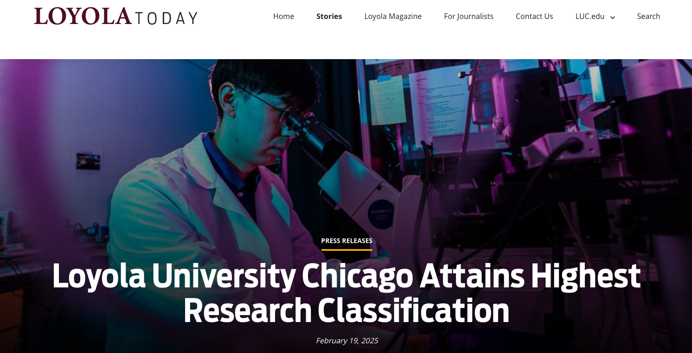
Loyola University Chicago is now designated as an R1 institution
(i.e., doctoral degree-granting and ”very high research activity”)
LOYOLA UNIVERSITY CHICAGO

Slide 4
The office of the VPR strives to:
Promote Awareness
  Examples:
    “Press Book” allows us to learn about the research ongoing by individual Pis across campus
    Funding opportunities
    Rules, Regulations & Best Practices in research
(Advocate for and define areas of) Investment
  Support our faculty’s competitiveness
    Seed/Pilot grants
  The “infrastructure”
Develop/Promote Mentoring Programs
  For faculty and campus leaders
    “the granting process”
    Roles and responsibilities
      best practices
      Ensuring compliance with the rules and regulations of research
LOYOLA UNIVERSITY CHICAGO

Slide 5
Example of an entry in the Press Book:
Intended audience:
Leadership
(President, Provost, Deans)
Marketing/Communications
Development/Advancement
Faculty
LOYOLA UNIVERSITY CHICAGO

Slide 6
Framing today’s conversation……
Who should I contact if I have a research-related question?
For Grants
For Contracts
For disclosure of Intellectual Property
For disclosure of Conflicts of Interest

Slide 7
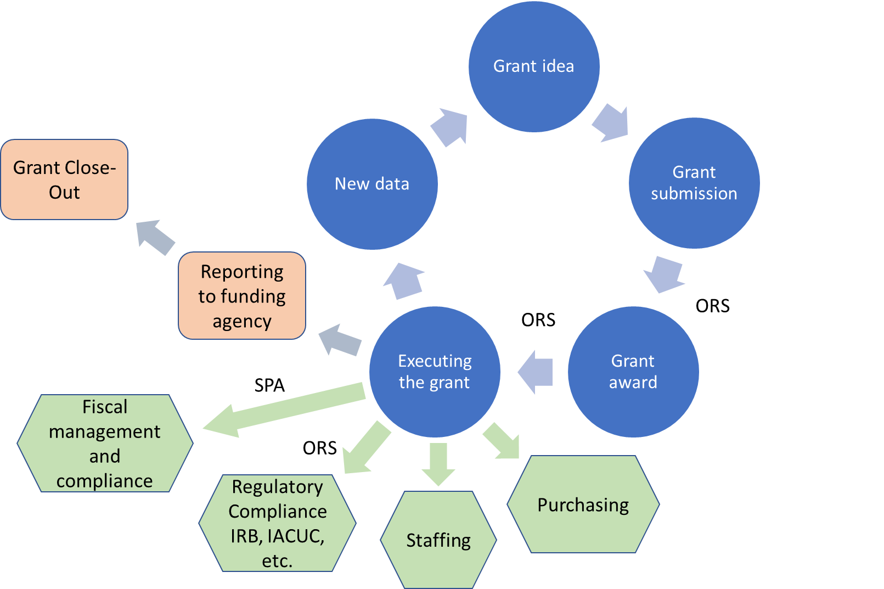
The life cycle of a grant
(and supporting elements):
KEY POINT TO REMEMBER:
PI has a critical role to play
in ALL of these elements
Abbreviations:
ORS: Office of Research Services
SPA: Sponsored Program Accounting
IRB: Institutional Review Board
IACUC: Institutional Animal Care and Use Committee
LOYOLA UNIVERSITY CHICAGO

Slide 8
The OVPR Website is a useful resource
https://www.luc.edu/ovpr/
Should be viewed as the primary gateway for information that supports your research
  Information about funding opportunities (internal and external)
  Policies (or changes)
  Highlighting our faculty’s research
  etc, etc.

Slide 9
I want to get feedback on a “mature” draft of my grant. Who can I go to?
Local resources:
  Colleagues
  Dean-designated “leads” for grants/research support (e.g., Associate Dean of Grants in CAS, Dr. Dan Killelea, Associate Dean of Research in SSW – Dr. Michael Dentato; Associate Dean of Research in MNSON - Dr. Todd Ruppar; Associate Dean for School of Education – Dr. Pamela Fenning; Vice Dean of Research, SSOM - Dr. M. Singh)
  Departmental resources: Grants Administrators
Office of the Vice Provost for Research
  Send request to Ms. Samantha Bynum (sbynum1@luc.edu)
  Internal Grant Review Program – get your grant to us 30 days in advance of its due date and we will solicit independent, formal feedback from experienced* researchers
    https://luc.infoready4.com/#competitionDetail/1847997 (you will need to login to InfoReady)
  *Experienced: those who have served on regional or national grant review panels
LOYOLA UNIVERSITY CHICAGO

Slide 10
If I have a grant idea but don’t know where to “shop” my grant?
Local resources:
  Colleagues
  Dean-designated “leads” for grants/research support Departmental
  Resources: Grants Administrators
Pivot website: https://pivot.proquest.com/dashboard
School and Institutional Resources
  Lakeside campuses (Lakeshore and Water Tower)
    Claudia Orellana (corellana1@luc.edu )
  Health Sciences Campus
    Samantha Bynum – sbynum1@luc.edu
LOYOLA UNIVERSITY CHICAGO

Slide 11
Capitalize on BOTH internal and external sources of funding
Internal:
  Pilot/Seed grants
    Should serve to build a sustainable program of scholarly activity
      Not the “one-and-done” kind of scholarly projects
      There are discipline specific (e.g., Arts & Humanities) and in some cases School-specific pilot programs (RFC program in SSOM)
    New “pivot” grant program (to support faculty whose grants were terminated)
External:
  Various sources
    Federal – NIH, NSF, NEA
    State – Illinois State Board of Education
    Local – county/municipality funding mechanism
    Private foundation – The Bill and Melinda Gates Foundation
    Private not-for-profit – The American Heart Association
LOYOLA UNIVERSITY CHICAGO

Slide 12
Framing/advocating for investment
Examples:
Pilot seed grants
Software platforms
  Endnote – reference manager
  LabArchives
  An electronic Research Administration system (eRA) – Cayuse
    To be fully deployed for use by December 2026
Capital Equipment
  To include providing assistance, as needed, for faculty to submit grants that help secure such equipment
LOYOLA UNIVERSITY CHICAGO

Slide 13
Who can submit a grant or negotiate a research-related contract…….
A member of ORS/Contracts
A member of Community Foundation Relations (CFR)
  Collaboration with ORS required
Leverage your departmental research administrators (if your department has one) who can assist with the preparation
  But department administrators do not submit the grant
Office of the Vice Provost for Research website is a good resource
Contact the Office of Research Services
  If you’re at HSC:
    Grants: RESEARCHHSD@LUC.EDU
    Contracts: CONTRACTSHSD@LUC.EDU
  If you’re at either Lakeside Campuses:
    Grants and Contracts: ORS@luc.edu
LOYOLA UNIVERSITY CHICAGO

Slide 14
A note about Contracts……..
Examples of agreements/contracts typically negotiated:
Non-disclosure Agreements
Data Sharing Agreements
Clinical Trial Agreements
(Non-clinical) Research Agreements
Service Agreements
Collaborative Research Agreements
LOYOLA UNIVERSITY CHICAGO

Slide 15
Some Dos and Don’ts:
DO GIVE YOURSELF TIME TO PLAN FOR A SUCCESSFUL GRANT/CONTRACT SUBMISSION
  SEEK ASSISTANCE FROM LOCAL AND INSTITUTIONAL RESOURCES
  TAKE AN ACTIVE ROLE IN LEARNING ABOUT THE ”RULES”
    When in doubt, please reach out
    Plan ahead (last minute submissions to the ORS may not be submitted)
DO NOT SUBMIT ANY GRANTS INDEPENDENTLY
  Always contact ORS for review
  Only the designated Institutional Official can sign off on research-related grant/contract paperwork (e.g., NDAs, DUAs/DSAs/DTAs, Research-related service agreements, CTAs, etc., etc.)
    LUC’s Institutional Official is: Meharvan Singh, PhD (Vice Provost for Research)
LOYOLA UNIVERSITY CHICAGO

Slide 16
“Technology Transfer”
What does this office do?
Reviews and negotiates Material Transfer Agreements
Assists faculty, students, and residents with disclosing inventions for potential patent protection
Negotiates partnering/licensing arrangements with other research institutions and commercial interests.
Technology Transfer Committee, composed of faculty members from basic and clinical science with established research portfolios, to review Invention Disclosures and make recommendations about the protection of intellectual property
LOYOLA UNIVERSITY CHICAGO

Slide 17
Noteworthy considerations:
BEFORE YOU PUBLISH OR PUBLICLY PRESENT, DO YOU HAVE SOMETHING POTENTIALLY NOVEL AND INNOVATIVE?
  How do you know?
ARE YOU SHARING OR RECEIVING MATERIALS/REAGENTS WITH OTHER RESEARCHERS?
Rachel Drucker, Technology Transfer and Contracts Administrator - rbeyler@luc.edu
LOYOLA UNIVERSITY CHICAGO

Slide 18
(Financial and Research) Conflict of Interest
What is it?
  A financial conflict of interest exists when an investigator's significant financial interest could directly and significantly affect the design, conduct, or reporting of the PHS-funded research.
    Significant financial interest: defined in dollar terms as > $5,000 (in 12 month period, from such external sources that include but are not limited to: honoraria, gift, consulting fee, royalty, intellectual property right, or paid authorship
“When in doubt, disclose”
  Disclosure is NOT admission of fault. Rather, it is merely an effort to allow an independent committee (Conflict of Interest in Research Committee – CIRC) to make a determination if there is a perceived or real conflict of interest.
    Even if such a determination is made, that doesn’t imply wrong-doing. Rather, it allows for the institution to help the investigator manage the conflict of interest.
LOYOLA UNIVERSITY CHICAGO

Slide 19
When in doubt…..
Contact the Office of the Vice Provost for Research:
Lakeside Campuses Faculty – Claudia Orellana - corellana1@luc.edu
Health Science Campus Faculty – Samantha Bynum
sbynum1@luc.edu
LOYOLA UNIVERSITY CHICAGO

Slide 20

There are people and support units in place to help
My request to you……
  Please take the responsibility of reaching out when:
    You’re unsure (about policy, practice/procedure, law (as it relates to research), etc.)
    Need assistance
WE’RE HERE TO HELP!
LOYOLA UNIVERSITY CHICAGO

Slide 21
Welcome to Loyola University Chicago !!!

